Slide 1
Introduction to Generative AI, Transformers & LLMs

Slide 2
Trainer Guidelines for Conducting Class
Solve questions live by creating new blank files (Excel, Python, Jupyter notebook, Dashboard) during the session, rather than sharing completed solutions.
Review teaching materials and solutions beforehand, and prepare additional examples to reinforce learning.
Ensure online students can hear you and see the screen clearly at all times.
Test your computer and necessary software before class begins.
Check with online students every 15-20 minutes to see if they understand the material and have any questions.

Slide 3
4
Generative AI Roadmap
3
3. Advanced Fine-tuning and Model Evaluation
4. Building a Real-Life Chatbot with Gradio Deployment
2
2. Training and Fine-tuning LLMs
1
1. Introduction to Generative AI, Transformers & LLMs

Slide 4
Agenda
Overview of Generative AI
Key features of generative models
Applications across industries
Ethical considerations and biases
Transformer architecture and components
Pre-training and fine-tuning of LLMs
Comparison of LLM Models (e.g., GPT-3, T5, Jurassic-1 Jumbo)
Hands-on with Hugging Face: Environment setup and model exploration
Text generation and summarization tasks implementation
Analyzing strengths and limitations of different approaches

Slide 5
What is Generative AI?
Generative AI is a transformative technology that utilizes machine learning to analyze existing data and generate entirely new content. This includes diverse modalities such as:
Text: Generate compelling stories, realistic news articles, poems, and scripts.
Images: Create high-quality images of objects, landscapes, and even people that don't exist.
Music: Compose unique and original pieces in various styles and genres.
Key features
Creativity: Unleash the power of AI to push the boundaries of human imagination and artistic expression.
Diversity: Explore hidden patterns and uncover new possibilities with a vast range of outputs from limited datasets.
Adaptability: Solve complex problems across diverse fields by training models on various data types and adapting them to specific tasks.

Slide 6
Cont…
Examples
Text Generation: Craft realistic and coherent text for news articles, poems, scripts, and other forms of creative writing.
Image Synthesis: Generate high-quality, original images of objects, landscapes, and even people, revolutionizing design, advertising, and virtual environments.
Music Composition: Compose unique and novel pieces in various styles and genres, impacting the music industry with innovative forms of expression.
Generative AI represents a transformative technology with the potential to unlock significant advancements across industries and enhance creative endeavors.

Slide 7
Generative AI's Impact Across Industries
Generative AI's applications extend far beyond mere content creation, transforming various industries with its innovative capabilities.
Healthcare
Medical Report Generation: Generate accurate and detailed medical reports, freeing up physicians' time for patient care.
Drug Discovery: Accelerate drug discovery by generating new molecules and simulating complex biological processes.
Finance
Risk Assessment: Predict market trends and assess investment risks with enhanced accuracy.
Fraud Detection: Identify fraudulent activities faster and more efficiently, safeguarding financial systems.

Slide 8
Cont…
Content Creation
Writing Assistance: Assist writers with crafting content, generating outlines, and overcoming writer's block.
Creative Content Generation: Produce engaging and original content, including poems, scripts, and marketing materials
Conversational Agents
Chatbots: Develop engaging and helpful chatbots that can provide customer service 24/7.
Virtual Assistants: Enhance user experience with personalized virtual assistants that can handle various tasks
Research
Data Augmentation: Generate synthetic data to enhance research studies and improve model performance.
Hypothesis Generation: Formulate new and innovative research hypotheses based on vast datasets.

Slide 9
Ethical Considerations and Potential Biases
Bias: AI models are trained on data, and any biases in that data can be reflected in the outputs they generate. This can lead to unfair or discriminatory results.
Mitigation: Developers can use various techniques to mitigate bias, such as diversifying training data and using debiasing algorithms.
Monitoring: It is important to continuously monitor AI models for bias and take corrective action as needed.
Guidelines: We need ethical guidelines for the development and deployment of AI, to ensure it is used responsibly and benefits everyone.

Slide 10
Introduction to Transformers
Evolving Beyond RNNs
For a long time, Recurrent Neural Networks (RNNs) were the dominant architecture for processing sequential data like text. However, they suffered from limitations such as:
Vanishing gradients: Long sequences could cause gradients to become too small, hindering learning.
Serial processing: RNNs need to process each element in a sequence sequentially, limiting their speed.

Slide 11
Cont…
The Transformer's Arrival
The Transformer architecture, introduced in 2017, revolutionized NLP by overcoming RNNs' limitations. It utilizes:
Self-attention mechanism: Allows each element in the sequence to attend to all other elements, capturing long-range dependencies effectively.
Encoder-decoder structure: Encodes the input sequence and then decodes it to generate the desired output.
Parallelization: Computes attention scores simultaneously, allowing for much faster training and inference compared to RNNs.

Slide 12
Cont…
Self Attention Mechanism
What it does:
Captures long-range dependencies between words.
Understands context for richer interpretations.
Enables efficient parallelization for faster training and inference.
How it works:
Each word gets "query," "key," and "value" vectors.
Attention scores measure how relevant each word is to others.
Words are combined based on their relevance, creating richer representations.

Slide 13
Cont…
Parallel Processing Power
Unlike RNNs, which process elements sequentially, transformers can calculate attention scores for all pairs of elements simultaneously. This enables them to take advantage of parallel processing capabilities of modern hardware, significantly accelerating training and inference.
Transformers have become the fundamental building block for many NLP applications, including:
Machine translation
Text summarization
Question answering
Dialogue generation
Text generation

Slide 14
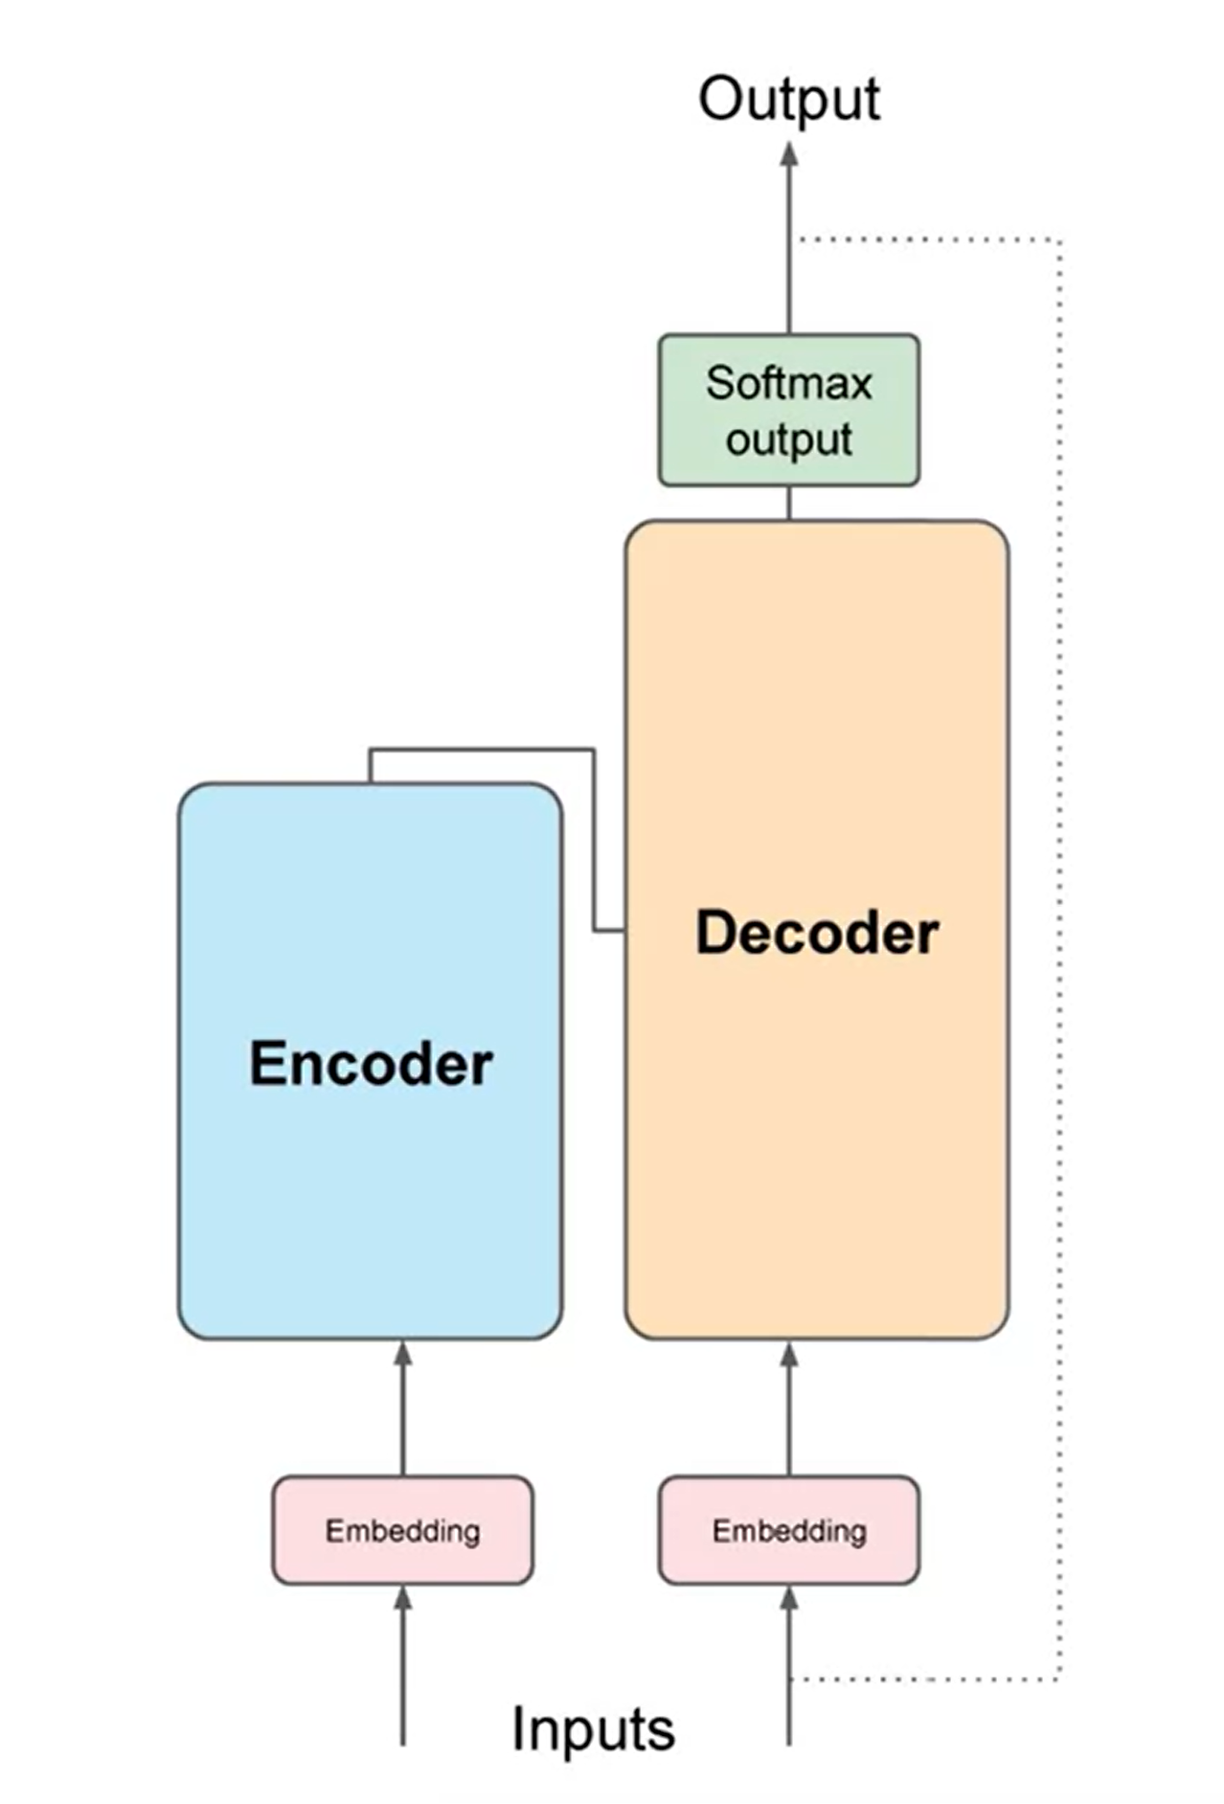
Cont…
Overview & Key Components of Transformers Architecture
Encoder
Input Embedding: Convert words into vector representations, capturing meaning and context.
Positional Encoding: Add positional information to understand word order.
Multi-Head Attention: Allow words to attend to others simultaneously, capturing diverse relationships.
Feed-Forward Network: Refine element representations through fully-connected layers.
Normalization and Residual Connection: Stabilize learning with layer normalization and prevent vanishing gradients with residual connections.

Slide 15
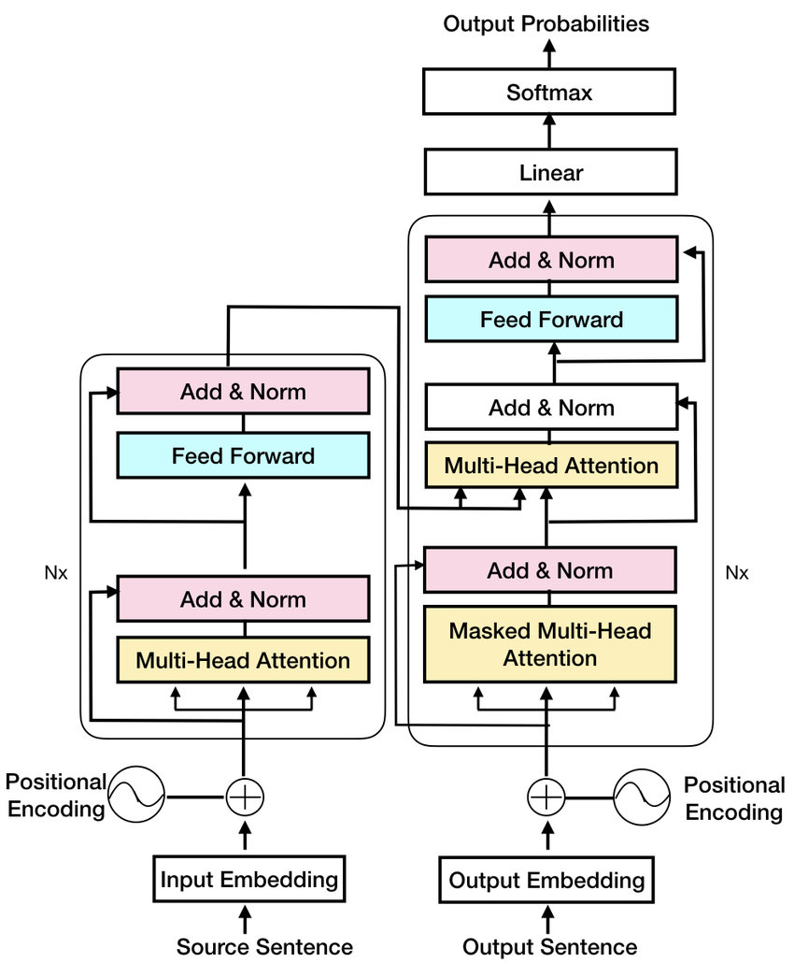
Cont…
Decoder
Decoder Input Embedding: Convert target sequence into vector representations.
Masked Multi-Head Attention: Prevent attending to future words, ensuring word-by-word generation.
Encoder-Decoder Attention: Attend to encoded representations for context in target sequence generation.
Feed-Forward Network and Normalization: Refine representations with a feed-forward network and layer normalization.
Output Projection: Project final decoder representation into the output vocabulary for word generation.
Parallelization: Transformers excel in parallel processing, computing attention scores for all pairs simultaneously, accelerating training and inference..

Slide 16
Introduction to Large Language Models (LLMs)
LLMs, a class of AI models, are trained on vast text datasets, enabling them to perform tasks like text generation, language translation, and answering questions. Key characteristics include large-scale data training, deep learning architectures (like transformers), multimodal capabilities, and adaptability through fine-tuning.
Key Features
Scale of Data: LLMs leverage vast datasets, surpassing hundreds of billions of words, for nuanced language understanding.
Deep Learning Architectures: Utilizing advanced neural networks, especially transformers, LLMs adeptly learn intricate language patterns and relationships.
Multimodal Capabilities: Some LLMs seamlessly integrate beyond text, incorporating images and audio, enhancing their versatility.
Adaptability: Highly versatile, LLMs can be fine-tuned for diverse tasks and domains, serving as adaptable tools across various applications.

Slide 17
Cont…
LLMs and Their Use Cases
General-purpose LLMs
Bard (Google AI): Versatile for creative text, translation, and question answering.
Megatron-Turing NLG (Google AI, Nvidia): Focuses on natural language generation.
Jurassic-1 Jumbo (Google AI): Known for factual accuracy and informative answers.
WuDao 2.0 (Beijing Academy of AI): Specialized in understanding and generating Chinese text.
BLOOM (BigScience): Multilingual, excels in translation and creative text.
Task-specific LLMs
LaMDA (Google AI): Dialogue-focused, excels in realistic conversation.
PaLM (Google AI): General-purpose with a focus on reasoning and problem-solving.
GPT-3 (OpenAI): Creative text generation, code, and translation.
Megatron-Turing NLG for Healthcare (Google AI, Nvidia): Specialized in medical text.
Jurassic-1 Jumbo for Science (Google AI): Specialized in scientific text.

Slide 18
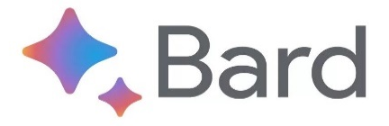



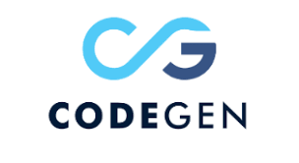
Cont…
Code Generation LLMs
CodeGen (OpenAI): Designed for generating code from natural language.
DeepCode (Google AI): Focuses on code understanding, bug detection, and suggestions.
AlphaCode (DeepMind): Generates code from scratch, solving coding challenges.
Research-focused LLMs
Switch Transformer (Google AI): Focuses on understanding relationships between words.
Pathway Language Model (PaLM - Google AI): Excels in reasoning, problem-solving, and research tasks.

Slide 19
Types of Transformer Models
1. Autoregressive Models: These models predict the next token in a sequence based on the previous tokens. They are ideal for creative text generation, code generation, and translation.
Example: GPT-3, BART
2. Sequence-to-Sequence Models: These models process the entire input sequence and generate a target sequence based on the information learned. They are versatile and can be used for text summarization, question answering, and machine translation.
Example: T5, Seq2Seq
3. Masked Language Models: These models learn by predicting masked words in a sentence, helping them understand word relationships and improve language understanding. They are often used as pre-training steps for other transformers.
Example: MLM, XLNet

Slide 20
Types of Transformer Models
4. Encoder-only Models: These models only use the encoder component of the transformer architecture to understand the meaning of text. They are widely used for sentiment analysis, entity recognition, and text classification.
Example: RoBERTa, ALBERT
5. Vision Transformers: These models leverage the transformer architecture for image processing tasks. They can analyze and understand images effectively and are used for image classification, detection, and segmentation.
Example: Vision Transformer, DeiT
6. Speech Transformers: These models utilize the transformer architecture for processing speech data. They are trained on large amounts of audio data and can achieve high accuracy in speech recognition and synthesis tasks.
Example: Speech Transformer, Conformer

Slide 21

Google Colab
Google Colab, also known as Google Colaboratory, is a hosted Jupyter notebook environment that allows you to write and execute Python code in your browser. It is completely free to use and requires no setup, making it a popular platform for machine learning, data science, and education.
Cloud-based: No need to install software; runs on Google's servers with access to GPUs and TPUs.
Free to use: No usage limits or cost; accessible to everyone.
Jupyter notebooks: Supports code, text, images, and multimedia in a single interactive document.
Easy sharing: Share notebooks via link for seamless collaboration.
Pre-installed libraries: Comes with popular ML and data science libraries, saving installation time.
Automatic version control: Saves work to Google Drive for easy progress tracking and collaboration.
Open source: An open-source project, continuously improved and updated by contributors.
Launch Google Colab

Slide 22

Hugging Face
Hugging Face is a company and an open-source platform that focuses on Natural Language Processing (NLP) and provides a comprehensive ecosystem of tools and resources for developers, researchers, and students.
Open-Source NLP Hub: Hugging Face is a platform providing open access to a diverse collection of pre-trained NLP models.
Transformers Library: Widely-used open-source library simplifying work with transformer-based models, offering pre-trained models and utilities.
Community Collaboration: Actively encourages collaboration and knowledge-sharing within the global NLP community.
Training and Deployment Tools: Provides tools not just for accessing but also training and deploying NLP models.
User-Friendly Interfaces: Emphasizes user-friendliness with easy-to-use interfaces and APIs for both beginners and experienced practitioners.
Educational Resources: Offers documentation and resources to support users in understanding and utilizing NLP capabilities effectively.

Slide 23
Cont…
Exploring Pre-trained LLM Models
Browsing available models on Hugging Face:
Explore popular LLM models like Flan-T5, GPT-2, and Jurassic-1 Jumbo.
Filter models by task, language, and model size.
Read model descriptions and documentation for detailed information.
Understanding model specifications:
Familiarize yourself with model parameters like number of parameters, architecture type, and supported tasks.
Consider the trade-off between performance and computational resources when choosing a model.

Slide 24
Practical Exercise
Implementing Text Generation, Summarization and translation Tasks
Note: Use Google Colabotory
Notes:
Use .ipynb File for this exercise (in Google Colab)

Slide 25
Thank You

